Slide 1
Making Diversity, Equity, and Inclusion in STEMM the Norm
Science, technology, engineering, mathematics, and medicine

Slide 2
Arguments for Diversity
Moral arguments
Demographic trends
Social justice issues
DIVERSITY IS CRITICAL TO EXCELLENCE IN STEMM
Notes:
Diversity has been an issue and talking point in STEM and Biomedical fields for decades.
Federal and privately funded programs have existed since these discussions began.
It is still common that individuals believe that STEM fields are acultural and diversity efforts are antithetical to the ideal of that STEM is meritocracy where individuals rise and fall based solely on their ability and that the cream will rise to the top. But we know that there is bias, discrimination, and cultural factors that unevenly impact women and underrepresented population.
Morality & social justice
Demographic trends
Strengthening the STEMM enterprise
And there is clear evidence that DIVERITY IS CRITICAL TO EXCELLENCE IN STEMM…

Slide 3
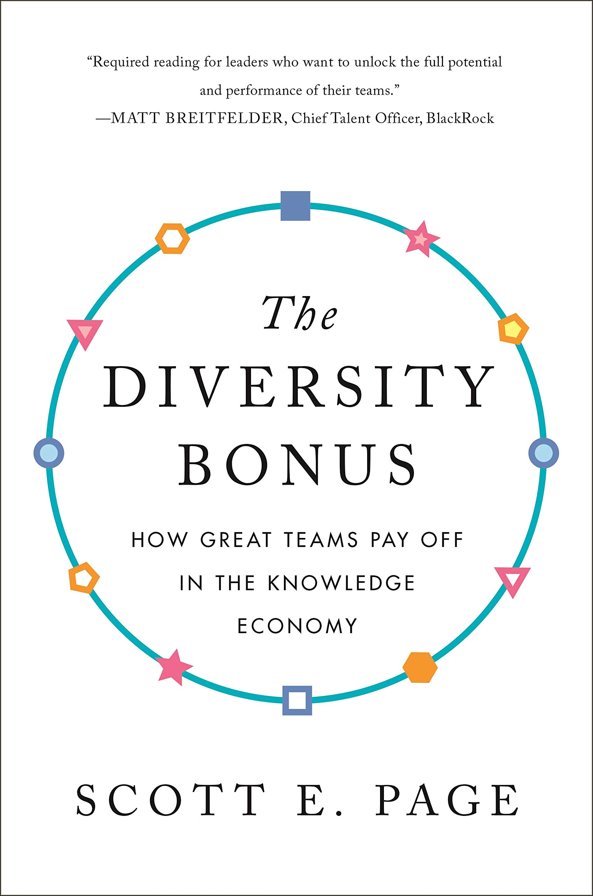
Notes:
There is compelling and consistent research from sociology, psychology, economics, education, team science, leadership, and career development to support the benefits of diversity in problem solving, learning, STEMM education and STEMM research.
In this literature, diversity is framed as the differences among a group of people ---their demographic characteristics, cultural identities and ethnicity, and training and expertise
Research on diversity in problem-solving refers to these sorts of characteristics, as “identity” diversity --- it shows that groups with greater identity diversity perform better than those that are more homogeneous.
For a truly compelling assessment of why diversity matters, “The Diversity Bonus: How great teams pay off in the knowledge economy” by Scott E. Page is a great place to start.
Teams of different kinds of thinkers outperform homogenous groups in complex tasks – improved problem solving, increased innovation, and more accurate predictions.

Slide 4
Why do we need to see change?

Slide 5
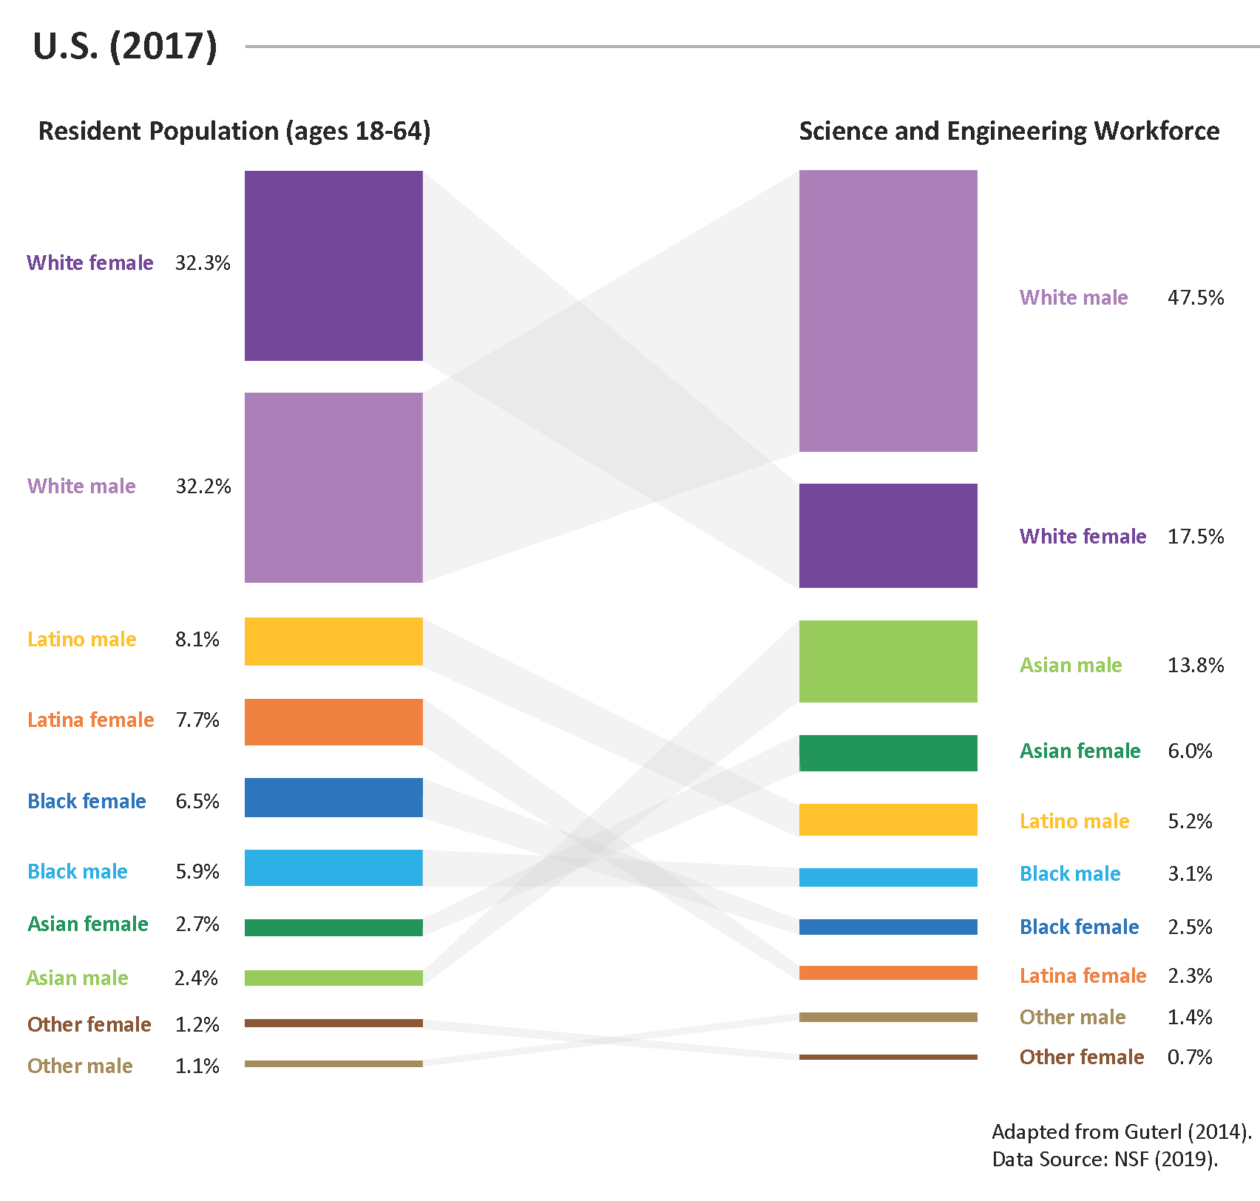
women
men
Representation in STEMM workforce doesn’t match the US population
Gender, race, and ethnicity intersect
men
women
men
men
women
women
women
men
men
men
women
women
men
women
women
men
men
women
Prepared by Lindsey Malcom-Piqueux
Notes:
Examining the US resident population in 2017 and the STEMM workforce, we can see over- or under-representation of different genders and race/ethnic groups. Importantly, these differences are intersectional – i.e. the representation of white women in STEMM vs. the US population is hugely reduced, while white males are overrepresented and make up almost 50% of the STEM workforce. The representation of Latino men is less in the STEMM workforce, but the disparity is even greater for Latina women.
There are also, of course, many other factors that lead to marginalization and bias in STEMM beyond gender, race, and ethnicity. We focus on these identities based on a 2017 survey of several institutions asking what information they gather regularly that they might use to explore inequities on their campus. The only thing consistently collected was binary gender, race, and ethnicity. Thus, these are currently our primary focus.

Slide 6
Community
Undergraduates
Tenure-Track Faculty
Tenured Faculty
3%
1%
8%
9%
Black
Latine Asian Indigenous Multiracial White
International Unknown
23%
32%
1%
2%
16%
8%
3%
25%
12%
7%
8%
3%
3%
26%
45%
51%
10%
2%
74%
18%
9%
6%
1%
Courtesy of Lindsey Malcom-Piqueux
Notes:
Notably, our faculty do not look like our students, and usually do not look like the surrounding community.

Slide 7
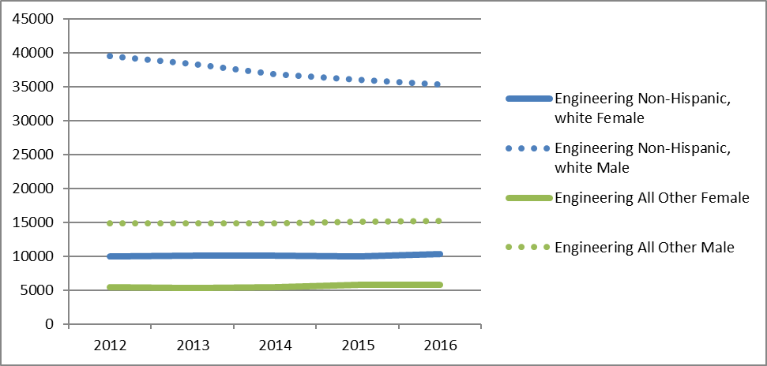
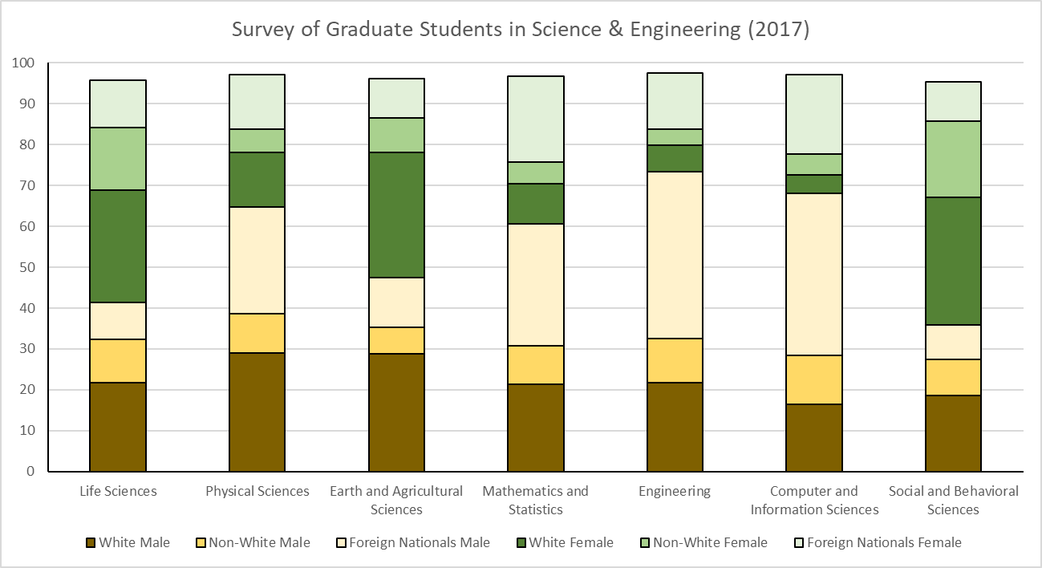
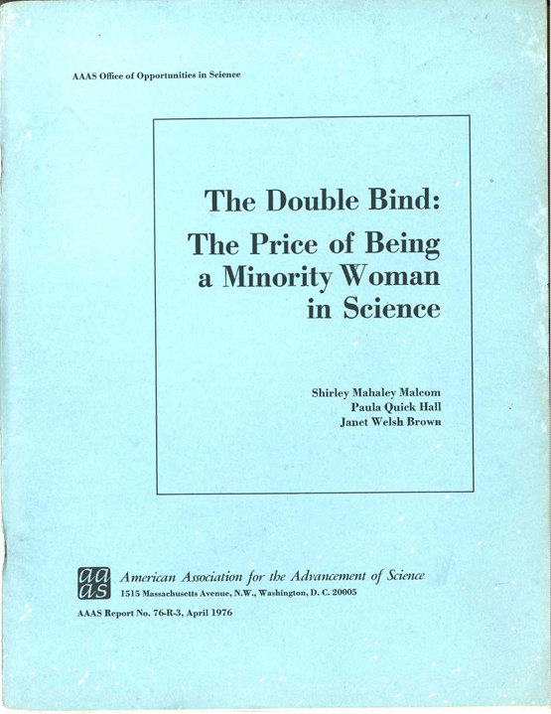
Engineering
White, Non-Hispanic Women
Intersectionality is a key consideration
Differences across STEMM fields
White, Non-Hispanic Men
All Other Women
All Other Men
Men
Men
Men
Women
Women
Women
NCSES Interactive Data Tool, Graduate Students by Demographic Characteristics and Enrollment
Notes:
Intersectionality is an important consideration in this context– see the intersectional makeup of engineering across time. There is also variation in representation across STEMM fields.
The experience of women of color in STEMM was documented in 1976 in “The Double Bind,” a report co-authored by SEA Change Director Shirley Malcom. Unfortunately, many of the issues described in the report are still relevant in 2021.

Slide 8
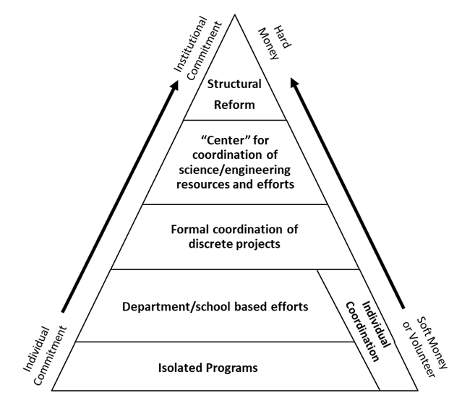
Model for meaningful change
Why hasn’t the needle moved?
Matyas, M.L., and Malcom, S.M. Women, Minorities, and Persons with Physical Disabilities in Science and Engineering. American Association for the Advancement of Science, 1991.
Notes:
“Intervention” programs refer to initiatives that serve to interrupt the status quo. For instance, a bridge program tailored for underrepresented undergraduates that helps them prepare for and enter into graduate school. Most interventions focus on communities of people considered to be underrepresented, at least in STEMM fields.
A model for the evolution of intervention programs details a change from isolated projects to structural transformation. To achieve true reform in the higher education system, commitment and funding at the institutional level is needed.
Most programs fall into the “isolated projects” or “department/school-based efforts” – they rely on soft money and do not have the commitment of the full institution. They are often started and maintained by a passionate individual (or group of individuals), many of whom volunteer their time.
What happens when intervention programs run out of external funding? If their director or champion leaves the university? Often, the programs are not institutionalized at that time. Without building that capacity, or changing the systems underpinning such efforts, interventions won’t be effective in the long-term.

Slide 9
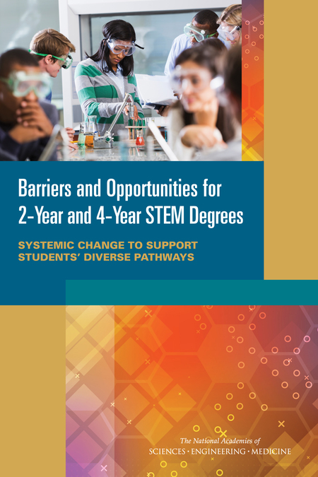
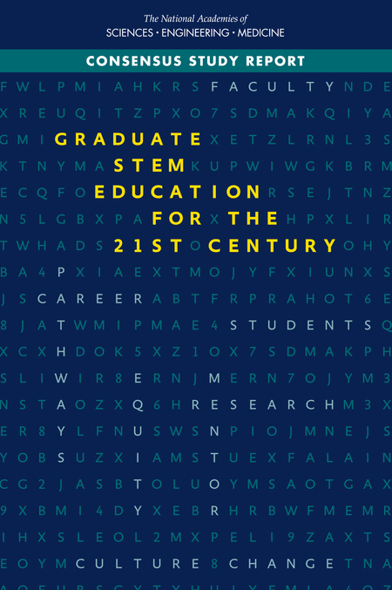
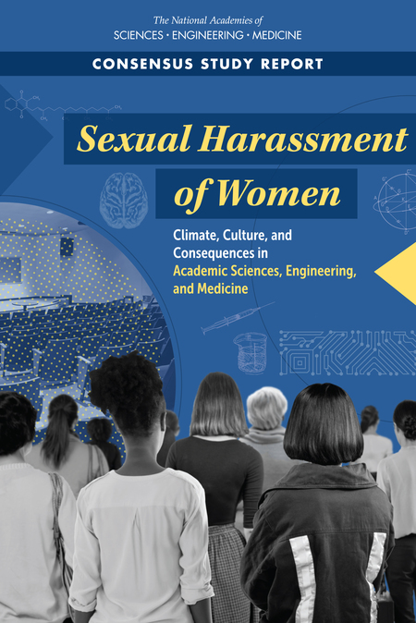
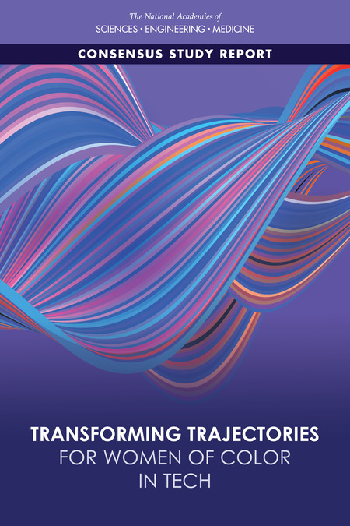
Notes:
Consensus reports and studies over the past several decades have called for systemic change, changes to culture and climate, as the main recommendation for addressing issues in higher education.

Slide 10
Equality Charters Process: Adapted Globally
Est. 2005
Est. 2014
Est. 2015
Est. 2015
Est. 2017
Est. 2019
Est. 2020
Notes:
The Athena Project was started in the UK in 1999 by a handful of women in universities who were fed up with the gender disparities in STEMM.
The program grew, and the Equality Challenge Unit (now part of Advance HE) launched Athena SWAN in 2005. In 2011, the UK Chief Medical Officer stated that funding would be tied to having a Silver Athena SWAN or above, and participation skyrocketed.
A 2014 external evaluation showed some progress, Athena SWAN had spread to Ireland, and ECU launched a separate Race Equality Charter in 2015. At the same time, SAGE was launched in Australia as an adaptation of Athena SWAN.
In 2015, a group of three women from the US went to spend time at Queen’s University Belfast. They were impressed with Athena SWAN and wondered if it could be brought to the US. They approached OSTP, but wisely OSTP suggested that an initiative like this could not sit in a government office in the United States. They recommended Shirley Malcom and AAAS as the next step.
SEA Change was launched as a pilot using the same fundamental framework as Athena SWAN, REC, and SAGE: institutional commitment to principles, holistic self-assessment framework, and cyclical peer-reviewed awards.
Since its initial launch, we have seen the launch of SEA Change Biomedicine in the US, Dimensions in Canada, and two pilot programs in India and Brazil.

Slide 11
“AAAS seeks to advance science, engineering, and innovation throughout the world for the benefit of all people”
Foster education in science and technology for everyone
Strengthen and diversify the science and technology workforce
…every other point in the AAAS mission
Notes:
Why AAAS? SEA Change aligns with the AAAS mission, and it is hard to choose which targeted objectives fit best with SEA Change. Arguably, it is all of them.

Slide 12
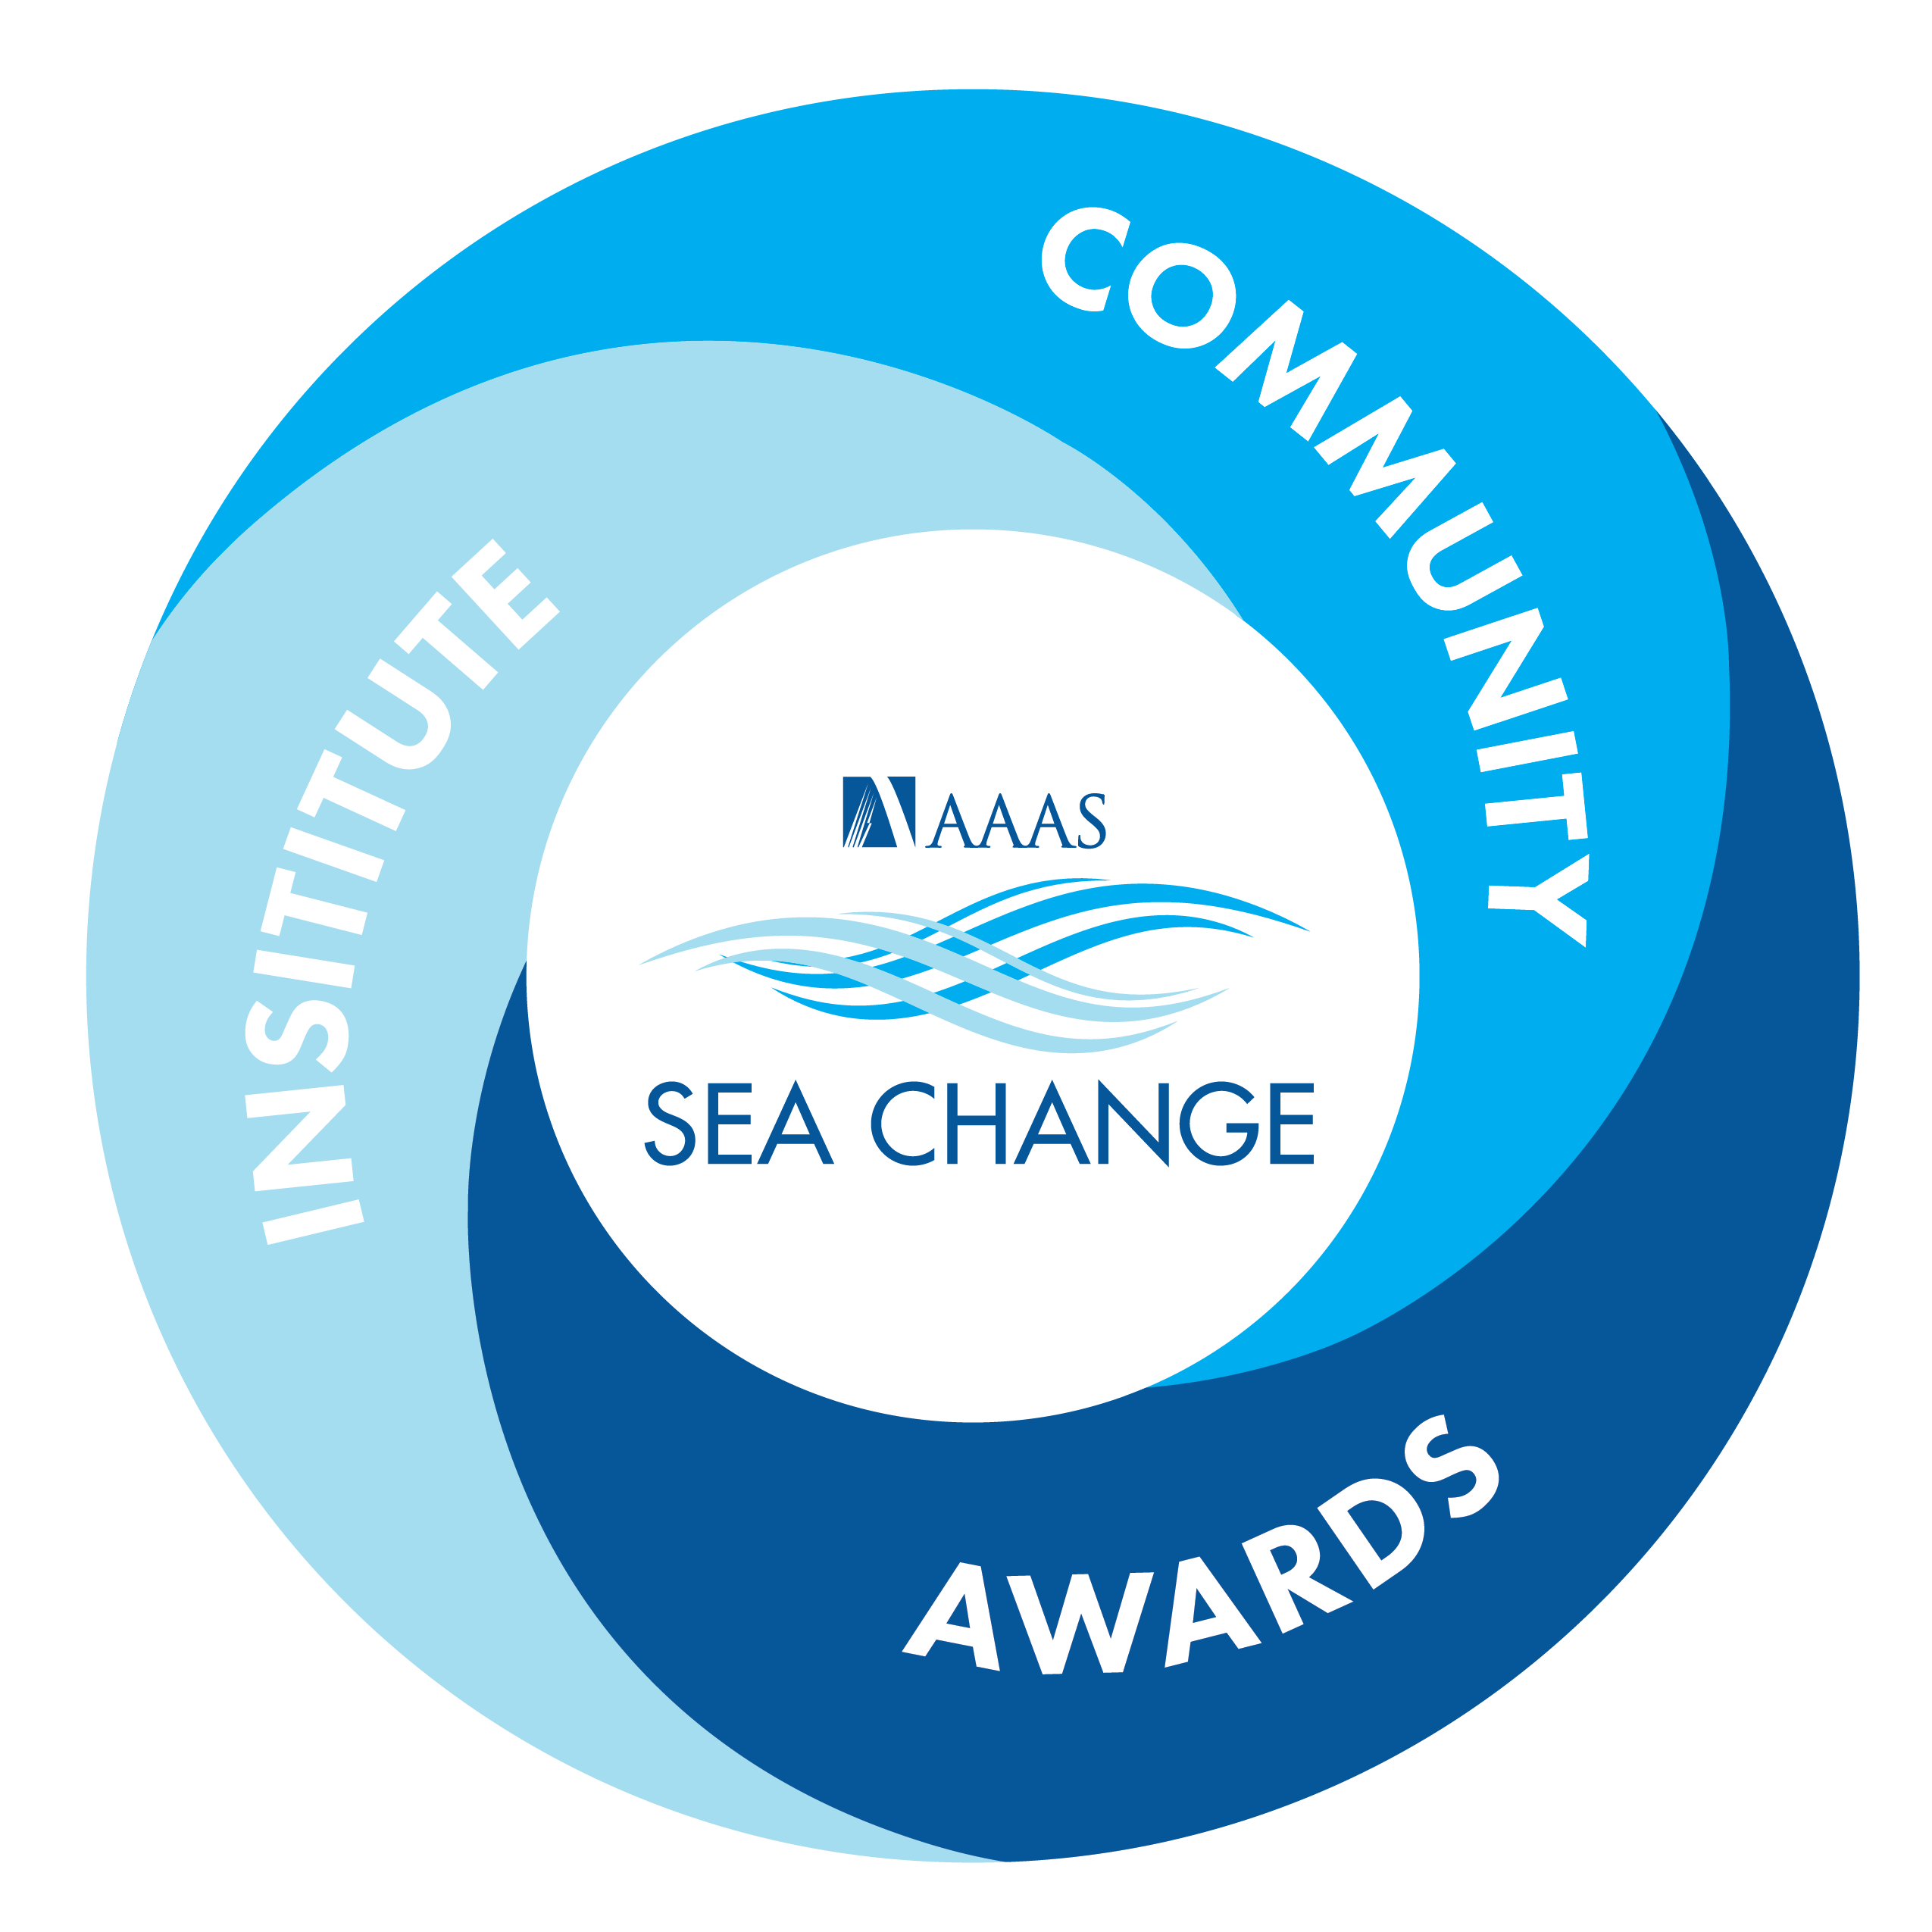
What is SEA Change
A keystone AAAS initiative that seeks to catalyze and sustain systemic institutional transformation to cultivate equitable and inclusive colleges and universities that support the success of all students and scholars.
Notes:
SEA stands for “STEMM Equity Achievement” Change.
We have adapted the Equality Charters Process to operate within the context of the US. Importantly, that includes consideration of federal and state legal parameters. Unlike the two separate equality charters in the UK, we knew that we must consider the intersectionality of identities from the start.
For institutions, SEA Change is:
An opportunity to stand up as a member of a global higher education community committed to shifting the culture of academia to one that is truly inclusive, equitable, and diverse
An opportunity to increase excellence in research and education
A public commitment to a set of Principles

Slide 13
SEA Change is different from other change initiatives
Builds the capacity of individuals and institutions to undertake a systemic approach to change
Provides a law-attentive lens via legal expertise
Leverages institutional context-relevant design
Prioritizes the use of an intersectional lens
Enacts a long-term commitment to dismantling structural inequalities through mutually-reinforcing cycles of iteration and renewal
Builds alignment with existing and future programs
SEA Change is not:
Another intervention
A “check-the-box” exercise
A ranking system
A magic bullet

Slide 14
SEA Change
Three Pillars

Slide 15
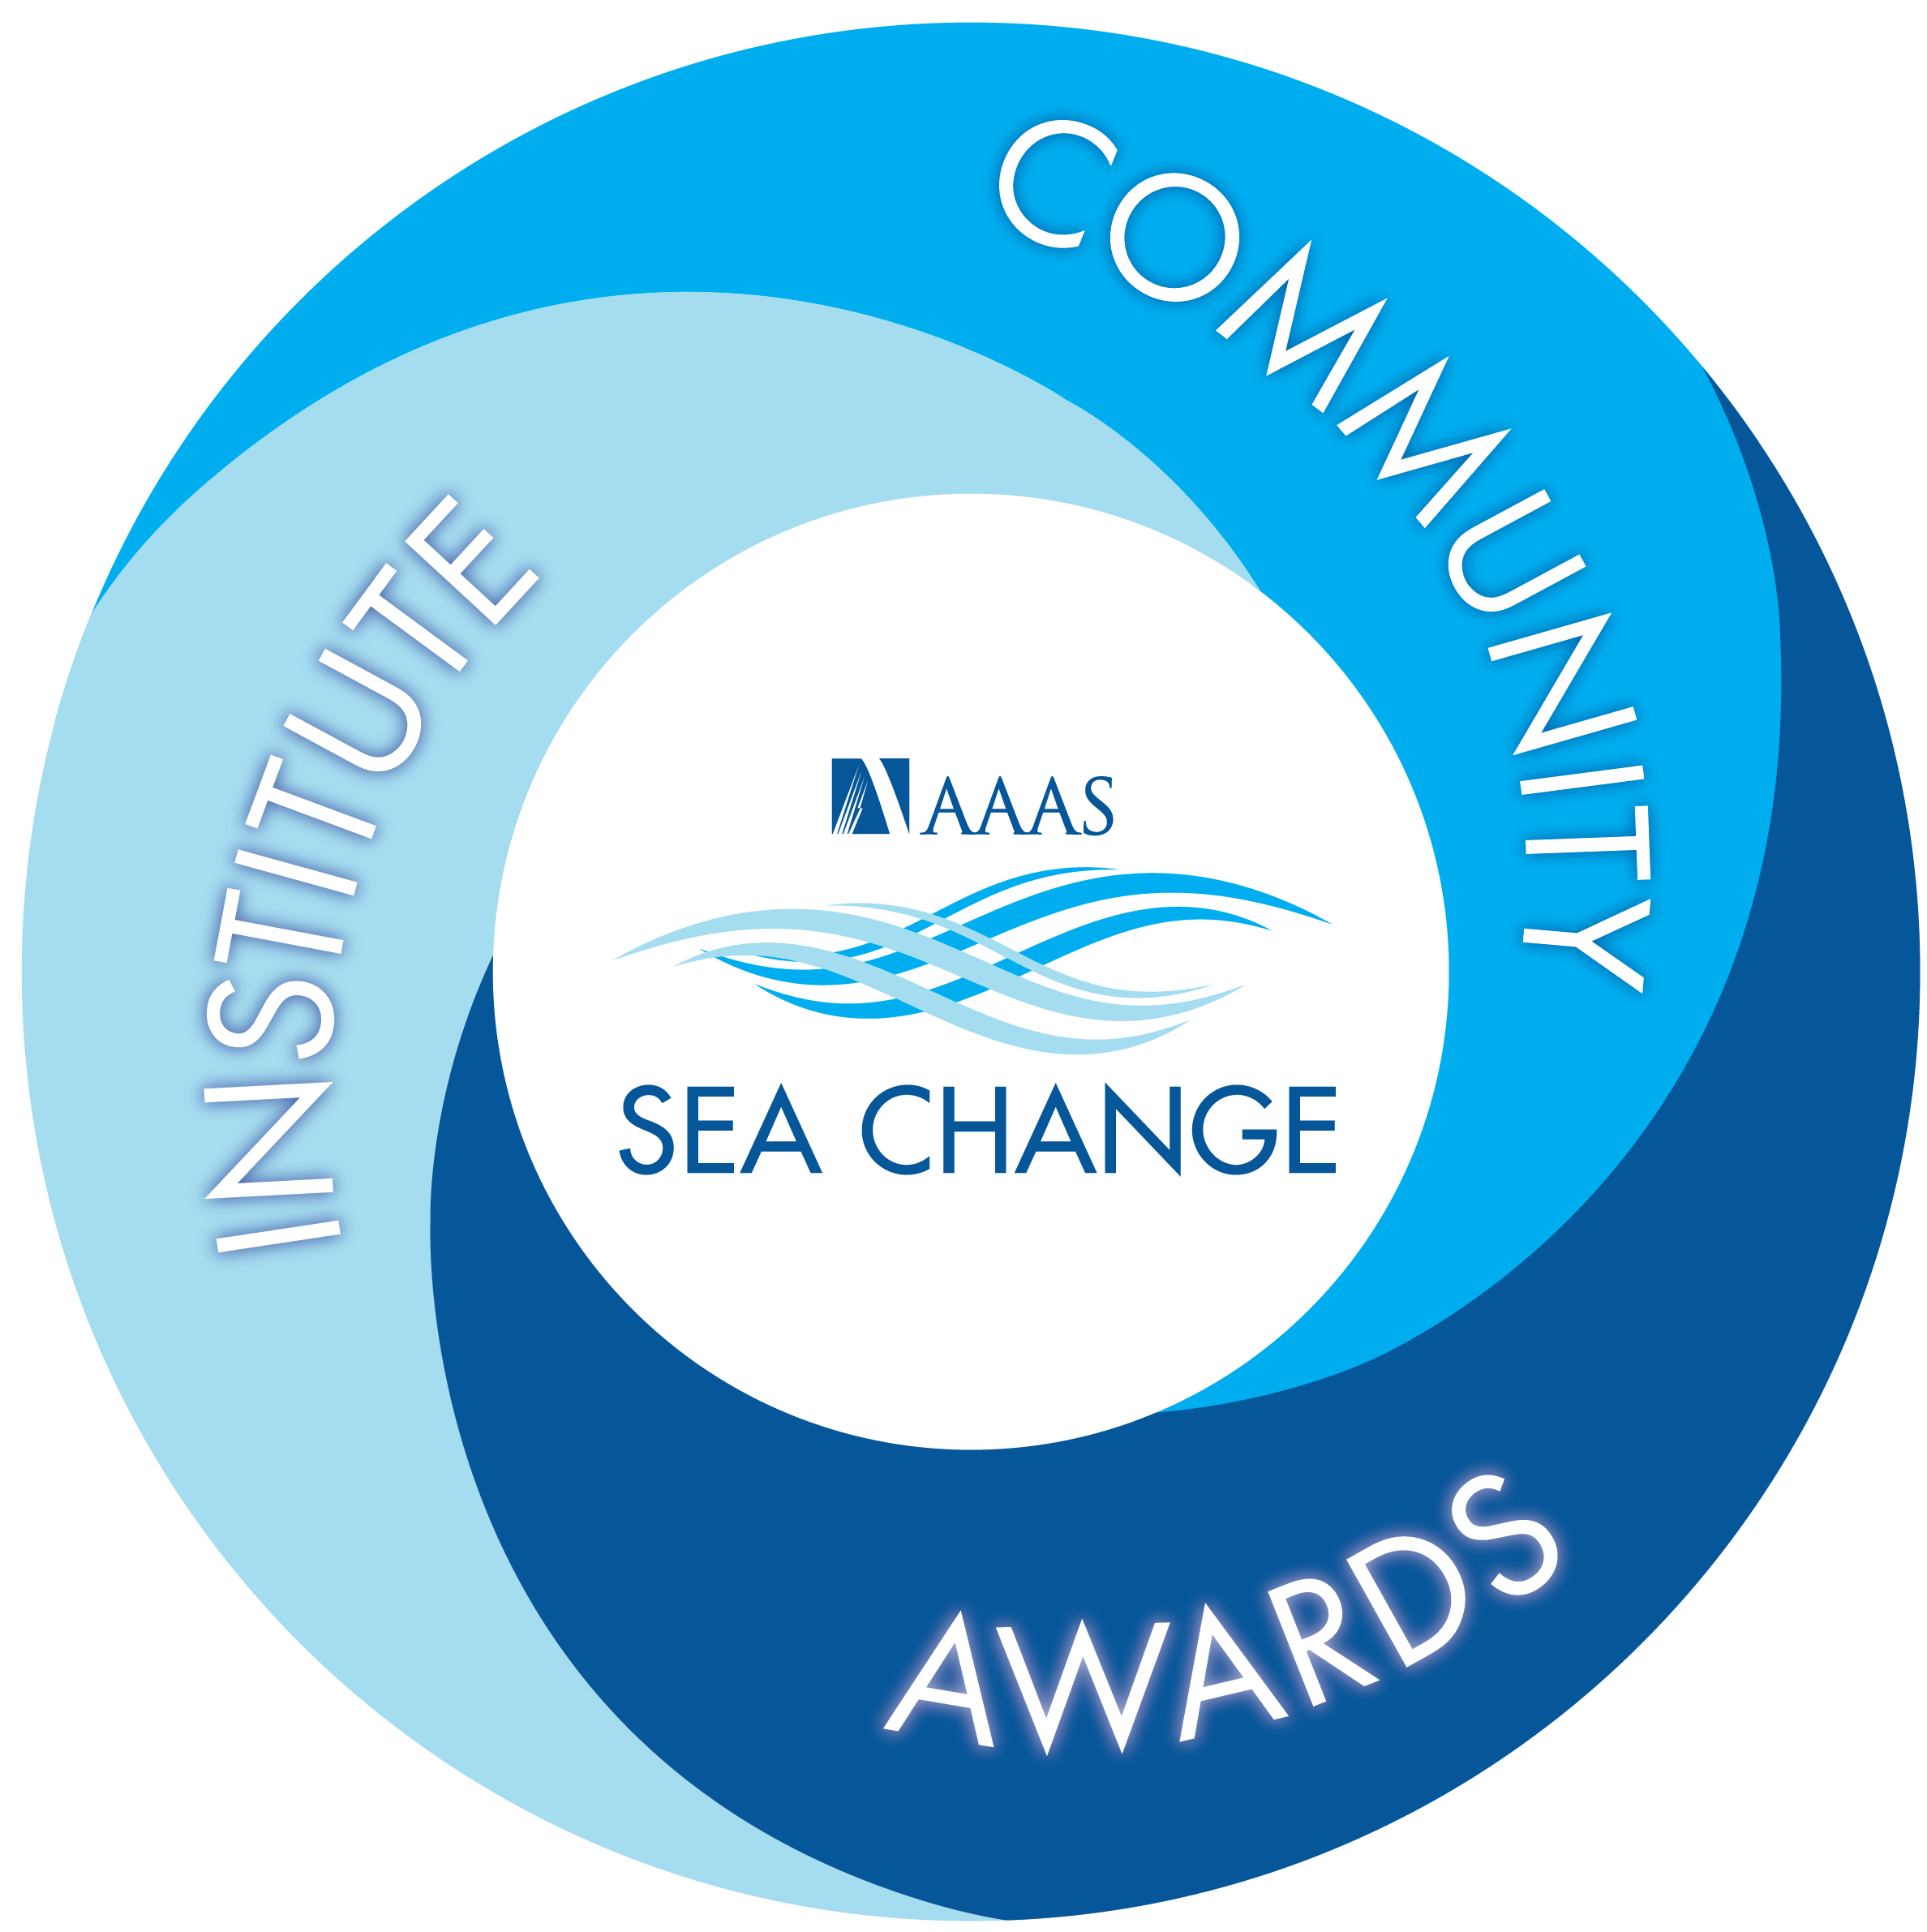
Membership
Notes:
SEA Change was designed as a virtuous cycle of iterative improvement.
SEA Change membership allows an institution to publicly commit to the SEA Change Principles, shifting from a reactive to proactive approach for diversity, equity, and inclusion within STEMM on campus.
SEA Change membership is comprised of three pillars:
The SEA Change Institute, which will offer courses, training, and convenings on research-based models and the implications of research to enhance institutions’ approaches to DEI challenges. A series of online training modules and resource library will be developed to build the capacity and knowledge base institutions need to use evidence-based strategies that address the barriers to equity and inclusion prioritized using a needs assessment.
The SEA Change Community, where stakeholders convene to build partnerships, collaborate on initiatives to open up and nurture the talent pool for STEM, and share information, research, and best practices.
The SEA Change Awards, a recognition system where colleges and universities, as well as their schools and departments, can be acknowledged for their work on true institutional reform supporting diversity, equity, and inclusion. These awards reflect a firm commitment to self-reflection and action, enhancing an institution’s ability to attract and retain the best students, faculty, and staff.

Slide 16
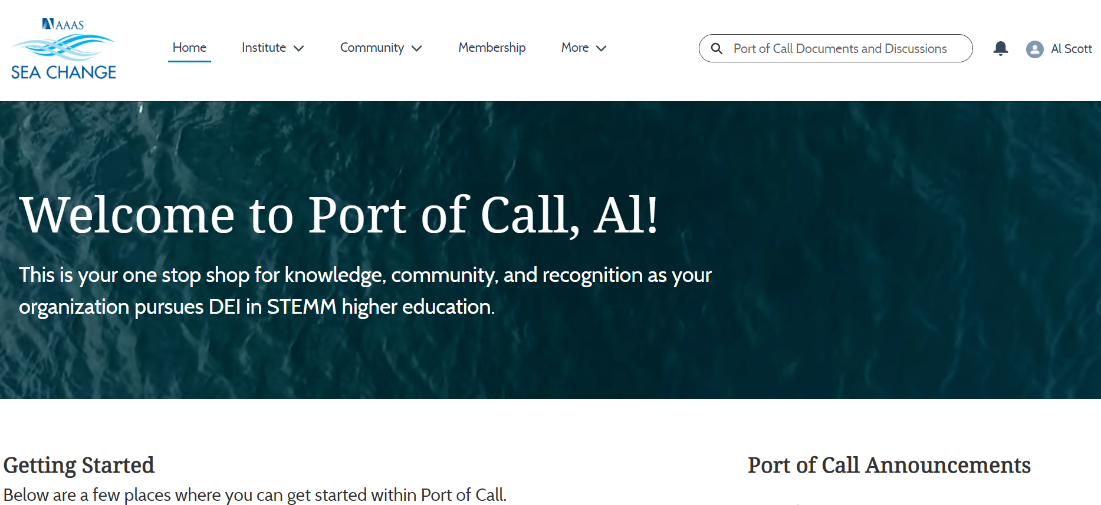
SEA Change Port of Call
A place to learn, to find resources, and build community
Notes:
SEA Change Port of Call is open to anyone who creates a free AAAS ID. There are Members-only areas and private groups, but the Community has many public groups open to anyone.
How to log in to Port of Call
Navigate to https://aaasseachange.force.com/
Use your AAAS ID to log in to Port of Call
If you do not have a AAAS ID, click “Create New AAAS ID” and complete the forms that follow & confirm your email to log in to Port of Call.
Not sure if you have a AAAS ID? Click “Forgot your AAAS ID?” to go to the AAAS ID lookup page
After logging in to Port of Call, you may be prompted to share your affiliation if SEA Change does not already have it on file
Enter and explore Port of Call

Slide 17
SEA Change Community
Communities of learning, practice, and circumstance
SEA Change Community Conversation & Interviews
Weekly highlights of the latest news & accomplishments
Notes:
The SEA Change Community is on Port of Call. Join for free and interact with peers similarly dedicated to DEI in STEMM within our topical groups available to all. There are some private groups and Members-only groups as well.

Slide 18
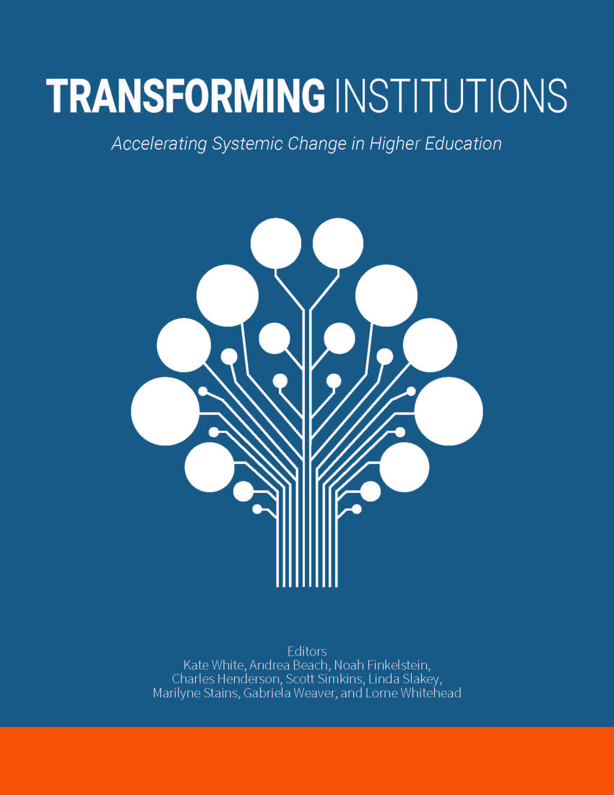
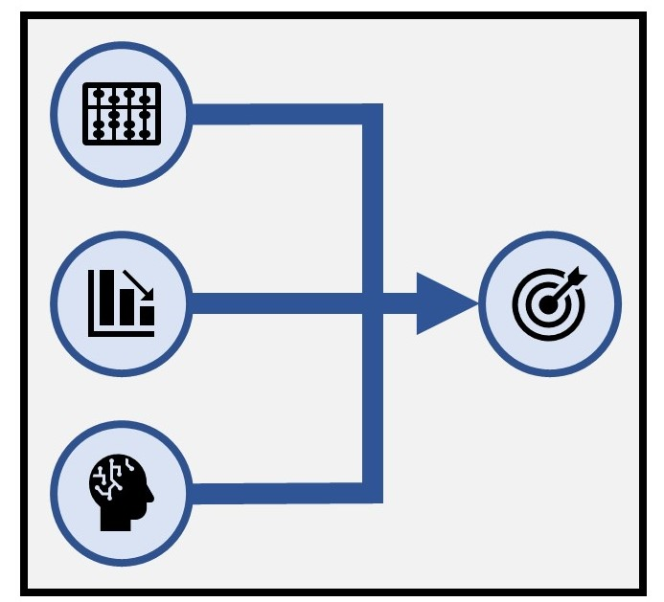
SEA Change Institute
Talking about Leaving Revisited:
Deep dive with the authors exploring their findings about why students leave STEM
Building Gender Equity in the Academy: Authors led exploration of the implications of findings from 20 years of NSF ADVANCE grants
Transforming Institutions: Practical guidance for applying systemic change research in STEM higher education
Data-Driven Decision Making: Building understanding on how to use data to remove the barriers that limit DEI

Slide 19
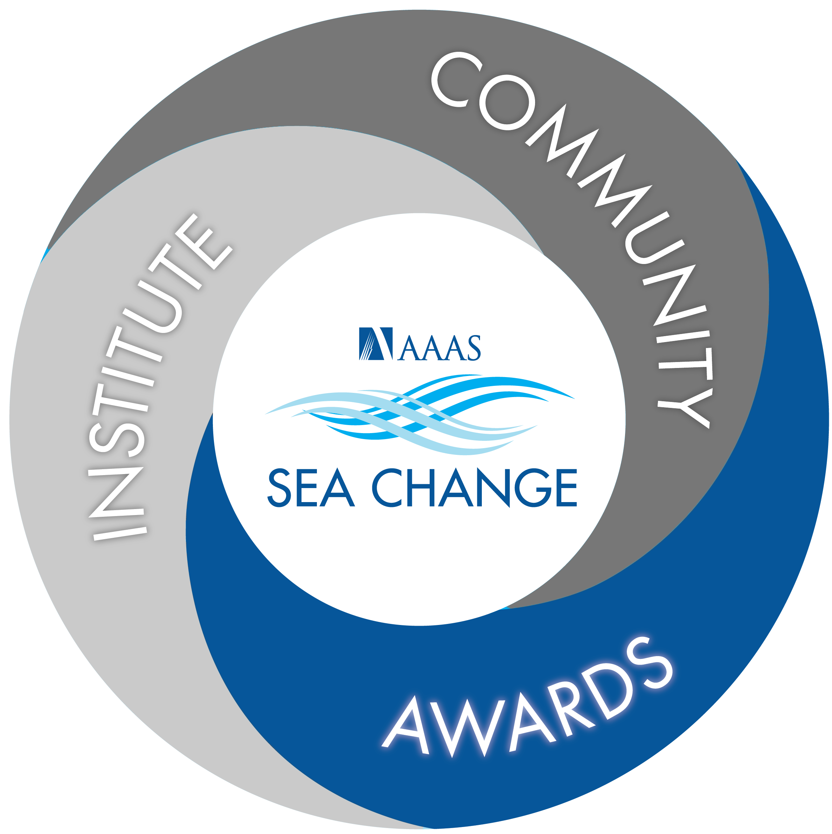
Notes:
The SEA Change Awards are the component of Membership that most people are familiar with.
Systemic transformation requires a simultaneous top-down, bottom-up approach. Institutional Awards will help set up the foundation needed to advance individual departments; the advancement of multiple departments will then help catalyze continuous improvement at the institutional level.
Letters of Intent to apply for a 2023 Institutional Bronze Award are due on April 30, 2022. Applications will be due on October 30, 2022. We recommend at least 13 months for a thorough self-assessment, understanding of findings, and development of an action plan. Only Members can submit LOIs and applications.
It will be several years before the Departmental Awards are fully up and running. Currently, SEA Change plans on partnering with committees of disciplinary societies to develop and administer discipline-specific departmental awards. The Physics & Astronomy working group has started the first cohort of Departmental Awards in 2021.
SEA Change Biomedicine-initial support provided by NIH Office of Research on Women’s Health
Also funded by the Robert Wood Johnson Foundation to create a landscaping database of medical schools
Collaborators include the Center for Women in Academic Medicine and Science (CWAMS), Association of Academic Medical Centers (AAMC), and the National Academies’ Roundtable on Black Men and Black Women in Science, Engineering and Medicine
We will be organizing focus groups and individual reviews when the criteria and guidelines are ready for public review – we welcome medical students, residents and others to review and comment
What’s the Ask?
An opportunity to participate as a potential pilot institution
Help us to co-create the framework, process, metrics
Monthly consultations from now to LOI through application
If your institution has a significant medical school or academic health science center, we encourage you to explore this track for those endeavors. It is tailored specifically to address the unique structures and culture found in US academic health science centers. Contact Darla Thompson (dthompson@aaas.org) for more information.

Slide 20
Awards Process
Specific, Measurable, Achievable, Relevant, Time-limited – SMART!
Notes:
Institutions do not share data directly with AAAS or any other entity. Rather, they use the self-assessment framework to explore the current state of DEI on their campus, particularly in STEMM fields. The framework guides institutions through collecting relevant evidence, identifying gaps in information, and exploring what the evidence reveals as possible barriers to equity. None of this information is disclosed to AAAS or any other entity.
The award application consists of two parts: a narrative and an action plan. The narrative allows the institution to tell its story, clearly demonstrating a thorough understanding of the findings of self-assessment and walking reviewers through the rationale for prioritizing some of the root causes of inequity discovered in this process. The action plan is the heart of the application – reviewers will assess if the action plan is SMART and if the institution is clear in its rationale for the actions chosen and prioritized. The peer-review process is meant to be positive, recognizing excellent progress towards systemic change. Reviewers want the institutions to succeed.

Slide 21
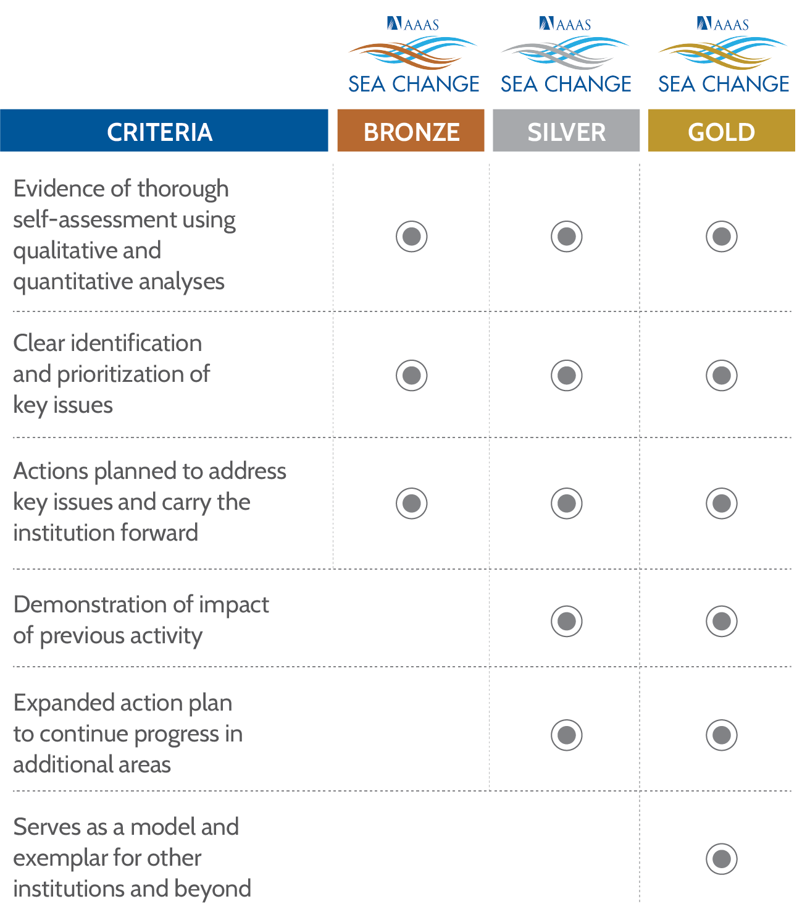
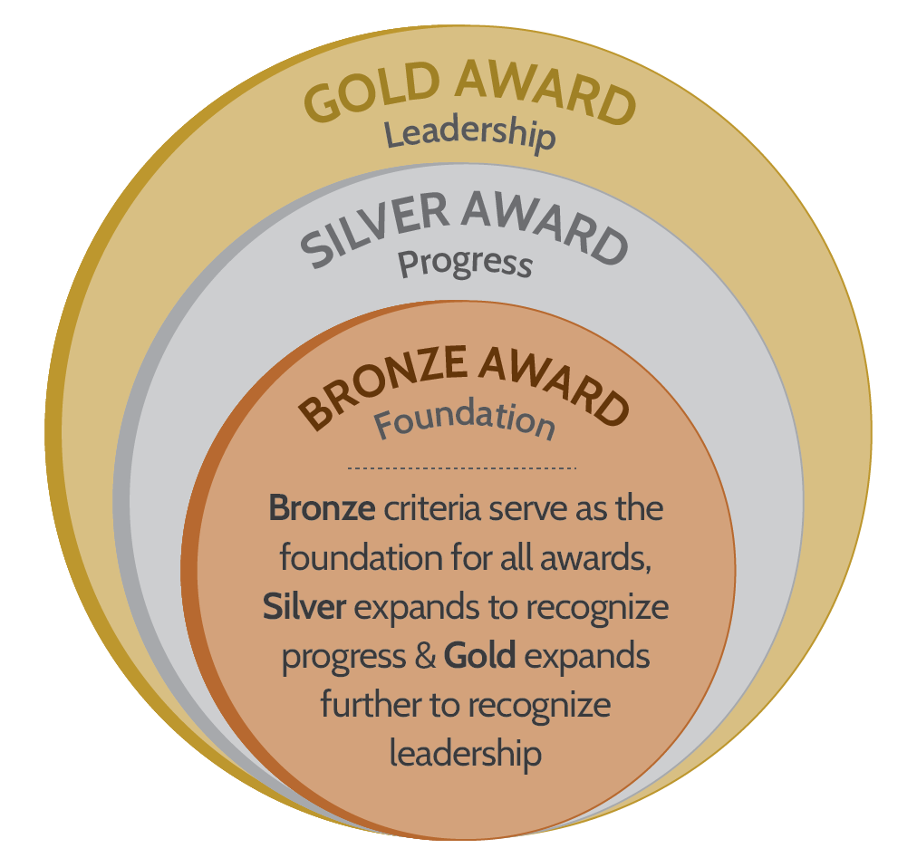
Award Levels
Notes:
SEA Change Awards use expanded criteria for each award level to recognize transformation efforts and progress. Bronze criteria serve as the foundation for all award levels, Silver criteria expand to recognize impact and progress of previous activity, and Gold expands beyond Silver to also recognize leadership
To prevent backsliding and to encourage capacity-building, awards must be renewed within five years, or they expire. At the time of renewal, institutions may decide to renew their current award level or to apply to progress to the next level.

Slide 22
Immersive Cohort Model
Specific, Measurable, Achievable, Relevant, Time-limited – SMART!
Notes:
Institutions do not share data directly with AAAS or any other entity. Rather, they use the self-assessment framework to explore the current state of DEI on their campus, particularly in STEMM fields. The framework guides institutions through collecting relevant evidence, identifying gaps in information, and exploring what the evidence reveals as possible barriers to equity. None of this information is disclosed to AAAS or any other entity.
The award application consists of two parts: a narrative and an action plan. The narrative allows the institution to tell its story, clearly demonstrating a thorough understanding of the findings of self-assessment and walking reviewers through the rationale for prioritizing some of the root causes of inequity discovered in this process. The action plan is the heart of the application – reviewers will assess if the action plan is SMART and if the institution is clear in its rationale for the actions chosen and prioritized. The peer-review process is meant to be positive, recognizing excellent progress towards systemic change. Reviewers want the institutions to succeed.

Slide 23
SEA Change Immersive Cohort Model

Slide 24
SEA Change Immersive Cohort Model
Onward
SEA Change cycle continues
Join community of transformation
Reapply for Bronze or apply for Silver

Slide 25
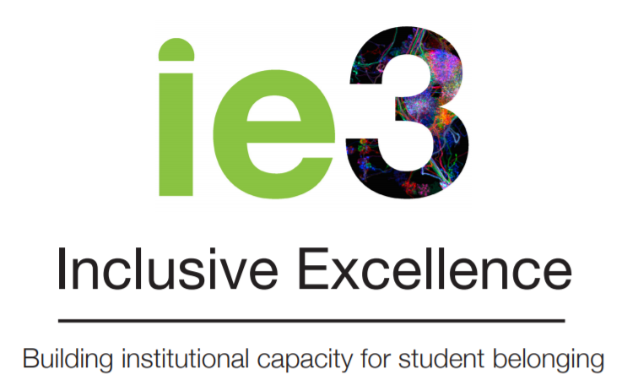
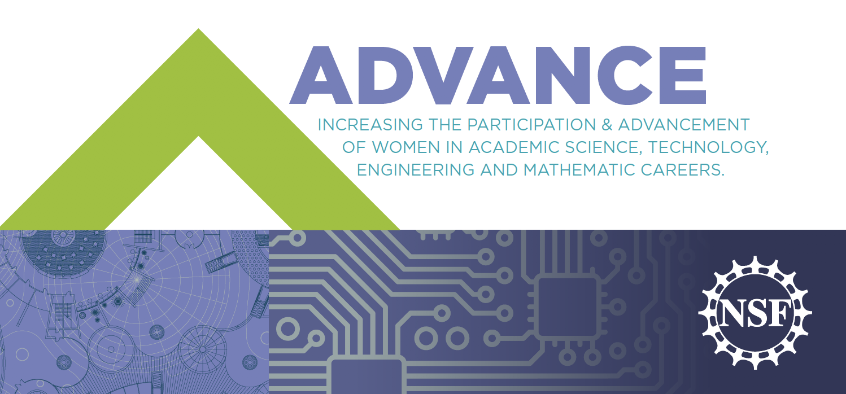
Use what you already have!
ICHANGE
Institutional Change Initiative
&
Notes:
Self-assessment is not an “easy lift” – change takes time and a great deal of effort. SEA Change framework for self-assessment is purposefully aligned with efforts campuses are already doing so that the administrative work of self-assessment is lessened.
If your campus is involved in any of the following efforts, work done within those initiatives can – and should – be used in the SEA Change application. Institutional Awards recognize institutions for work done trying to progress DEI on campus. If the campus is already doing good work, SEA Change is a chance to explore the effectiveness of those initiatives and receive recognition for prioritizing actions that will change the academic culture.
The programs listed here are not the only efforts that align with work that SEA Change is trying to promote. However, they are a good example of the collaborative efforts that AAAS is trying to take to ensure that work in the higher education DEI space is aligned. Aspire Alliance – Institutional Change: The Aspire Alliance is lead by the Association for Public and Land-granting Universities and the Center for Integration of Research, Teaching, and Learning. “The Institutional Change Initiative (IChange) seeks to cultivate institutions where STEM faculty from underrepresented groups (URGs) are widely recruited, hired, and retained, and all STEM faculty employ inclusive teaching, advising, and research mentoring practices. Institutional change requires a multilevel strategy of mutually reinforcing activities, including self-understanding, identification of levers for change, and use of resources for action.” https://www.aspirealliance.org/institutional-change Aspire Alliance IChange is the most similar initiative, and it has been purposefully aligned with SEA Change, including use of the same data template for internal institutional self-assessment. If an institution is part of IChange, they will be able to easily craft a narrative to accompany their action plan and submit that for peer review from SEA Change. As one institution said, “SEA Change is the exclamation point at the end of IChange.” APLU IChange and AAAS SEA Change meet weekly.
Inclusive Excellence from Howard Hughes Medical Institute (HHMI): “The HHMI Inclusive Excellence initiative challenges U.S. colleges and universities to substantially and sustainably increase their capacity for inclusion of all students, especially those students who belong to groups underrepresented in science. ” https://www.hhmi.org/science-education/programs/inclusive-excellence#Overview HHMI Inclusive Excellence focuses on underrepresented student populations and complements the SEA Change Institutional self-assessment at the same time it would supplement a SEA Change Departmental self-assessment.
NSF ADVANCE: The National Science Foundation “ADVANCE program seeks to develop systemic approaches to increase the participation and advancement of women in academic STEM careers.” https://www.nsf.gov/ehr/Materials/ADVANCEBrochure.pdf
ARC Network is an initiative out of AWIS and NSF: “The ARC Network strives to advance equity nationally by facilitating the adoption and implementation of evidence-based systemic initiatives by institutions of higher education and other STEM organizations that affect those in STEM workplaces. The ARC Network will facilitate authentic, intentional dialogue between researchers and practitioners, connect inclusiveness to organizational principles and practices, and account for and incorporate intersectional perspectives throughout our work.” ARC Network aligns with the SEA Change Institute and Community and we continue to work closely with them to ensure that we are co-creating and not replicating. https://www.equityinstem.org/about/
NSF INCLUDES: The National Science Foundation INCLUDES (Inclusion across the Nation of Communities of Learners of Underrepresented Discoverers in Engineering and Science) program “is a comprehensive national initiative designed to enhance U.S. leadership in science, technology, engineering, and mathematics (STEM) discoveries and innovations by focusing on broadening participation in these fields at scale.” https://www.nsf.gov/funding/pgm_summ.jsp?pims_id=505289
NASEM Action Collaborative on Preventing Sexual Harassment in Higher Education promotes convenings and creates working groups to help prevent sexual harassment in STEM. It is one method that an institution might wish to use to enhance efforts in harassment prevention and can be aligned with actions in an institution’s SEA Change action plan. https://sites.nationalacademies.org/sites/sexualharassmentcollaborative/index.htm

Slide 26
Annual Membership
Immersive cohort experience for first-time self-assessment
Opportunity to submit Institutional Award LOIs and applications
Limited number of registration fees for trainings, webinars, and in-person convenings waived; additional seats at deep discount
Site visits from SEA Change staff as requested and available (for training or consultation)
Public commitment to SEA Change Principles
Access to SEA Change Institute offerings
Access to Members-only areas of SEA Change Community
Total Expenses (Prior fiscal year)
≥ $1,000,000,000 | $30,000
$500,000,000 - $999,999,999 | $25,000
$100,000,000 - $499,999,999 | $20,000
$50,000,000 - $99,999,999 | $15,000
$10,000,000 - $49,999,999 | $10,000
≤ $9,999,999 | $5,000
Notes:
The SEA Change model for membership is geared towards sustainability and capacity building; to ensure that the initiative can successfully launch and grow, we cannot rely on external sources for infrastructure support.
After consultation with the National Association of College and University Business Officers, we propose a tiered annual membership fee structure based on total institutional expenses at the end of the prior fiscal year. It is important to note, however, that AAAS is very open to suggestions for other financial indicators or metrics to differentiate membership fee bands, ideally from your own business office.
We are mindful of the struggles caused by COVID-19; as such, on our Membership form there is a place to indicate anticipated expenses in the current or following fiscal year in the case that it drops an institution down to a lower Membership band.
Institutions who join as Charter Members will keep their Charter Member designation even when full membership benefits and fees launch in 2022.

Slide 27
Questions?
seachange@aaas.org
seachange.aaas.org

